Slide 1
Youth Homelessness Demonstration Program (YHDP) On-Site Meeting
Lauren Knott & Jenna Espinosa
December 4, 2019

Slide 2

Welcome and Introductions
Name
Pronouns (he/she/they?)
Icebreaker Q: If you could be any animal, what would you be and why?

Slide 3
Today’s Agenda
Quick recap of October meeting
Recap of decision making structure
DEBUT of vision and guiding principles
Data Walk
LUNCH!
System Mapping
Authentic Youth Collaboration with TCU

Slide 4
YHDP Key Requirements – A Recap
Develop a Coordinated Community Plan to prevent and end youth homelessness.
Apply for project funding in support of the Coordinated Community Plan using the e-snaps grant management system.
Involve Youth Action Board, public child welfare agency, and broad array of other partners.
Participate in evaluation to inform federal strategy for preventing and ending youth homelessness.

Slide 5
Coordinated Community Plan (CCP) Requirements
A statement of need (In progress!)
A shared vision (Debuting today!)
A governance structure for implementation, including an organizational chart and decision-making process (Finalizing today!)
A list of partners and a description of their involvement (In progress!)
List of goals, objectives, and actions steps with accountability (In progress!)
A list of all new YHDP projects, including, but not limited to, those to be funded by HUD
A plan for continuous quality improvement
A signature page (Signed by the Continuum of Care, Local Government, child welfare agency, and Youth Action Board)

Slide 6
YHDP Timeline
August 29th
December 29th
April 29th
July 1st
YHDP Awards Announced
Draft CCP due to HUD
Final CCP due to HUD
Project applications due to HUD

Slide 7
YHDP Decision Making Structures
Notes:
LK

Slide 8
Coordinated Community Plan Requirements
A governance structure, including an organizational chart outlining the governance structure
Two parts: identifies a decision-making process that includes how decisions regarding YHDP funds are made and by whom
The process is inclusive of a broad range of partners:
  Youth Action Board (YAB)
  CoC Collaborative Applicant and YHDP Lead Agency
  Child Welfare
  Local Government
  Youth Providers
  Homelessness Assistance Providers
  Education
  Justice
  Workforce

Slide 9
HUD’s Expectations of Governance and Decision Making
The process is respectful of the differing systems each partner represents and the goals and resources of those systems
The process is clear and transparent to the partners and public
There is a clear process for resolving disagreements
The process is subject to feedback and continual improvement
Remember, youth must have decision making power in all parts of YHDP, including the creation of the CCP and the selection and design of YHDP projects

Slide 10
Youth Action Board (YAB) Role in YHDP Governance
HUD requires the creation of a Youth Action Board, consisting of youth and young adults with lived experiences of housing instability and homelessness
No community can submit their CCP or project applications without the approval of the YAB
The YAB should have equal and respected voice at all decision making tables and at each level of the YHDP governance structure. Think about YAB roles within the larger CoC governance structure!

Slide 11
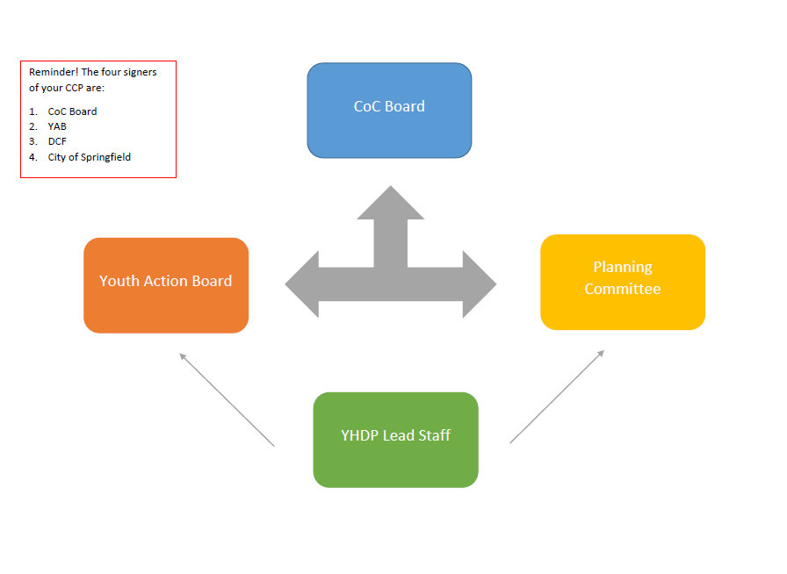
Proposed Org Chart
Notes:
Maybe the chart should make clear on who has to sign the plan vs. a decision making structure. The plan requirements are different from our by-laws so we should make that distinction. The other signatories need to know the importance of their participation too.

Slide 12
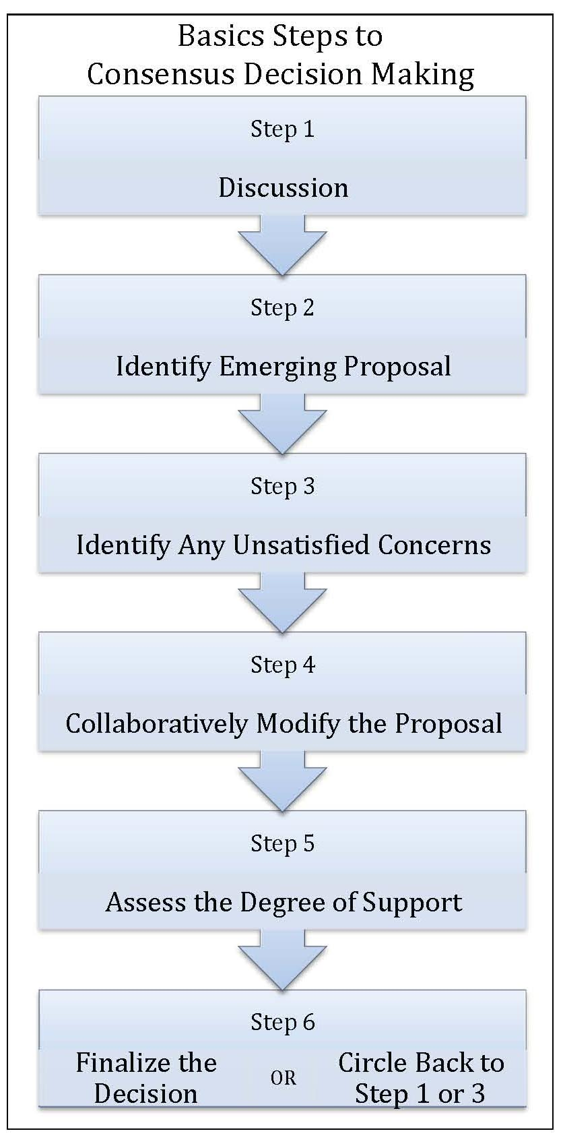
How Content of the Plan will be Decided
In the October meeting, folks in the room decided to follow the path your community has followed before, and use consensus decision making to decide what content will be included in the plan.
Key Pieces to Make Consensus Work:
At least 3 YAB members must be present for a decision to be made.
Present YAB members will be prepared to represent the YAB’s perspective. May need to take a decision back to the full YAB before a decision can be made.
Ensure every voice is heard by listening actively, using respectful disagreement, and following our meeting agreements.

Slide 13
Debuting Your Shared Vision!
Proposed Vision Statement for the Coordinated Community Plan:
“Youth and young adults in Hampden County have a safe and stable home, community, resources, and opportunities to live harmoniously and thrive.”
Notes:
AP

Slide 14
Guiding Principles
Leadership by youth and young adults
Collaboration between YYA and their older adult allies
Data-informed decision making and evaluation
Centering equity in all policy and programs
Community buy-in around the work of solving YYA homelessness
Relentless commitment to transparency, positive outcomes, and innovative and sustainable solutions

Slide 15
Data Walk
Around the room, we’ve posted a variety of data about Hampden County and nationally
Take about 15 minutes to walk around and reflect on the data
As you’re stopping at each piece of paper, ask yourself…
  What is surprising about this data?
  What confirmed what you already know?
  Do you know of another data set in the community that we could be using to access more information about this population?
  What’s missing?
We’ll do a popcorn report out at the end

Slide 16
Hampden County 18-24 System Mapping

Slide 17
Today’s Goals
See how youth are moving through the system
Imagine what new pathways might be developed
Your Role:
Tell us how you are seeing youth homelessness in your community
Imagine what the system could look like – BE CREATIVE!
Notes:
Depending on what we have from Monday night’s meeting- let’s think about ways to integrate. Post these up afterwards?

Slide 18
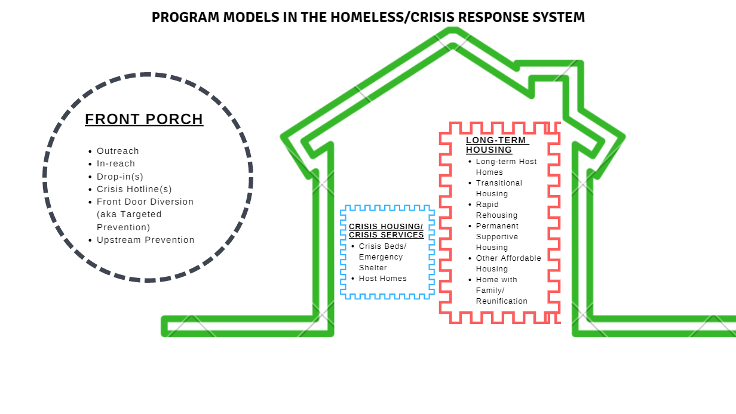
Program Models in the Homeless/Crisis Response System
Notes:
Prompt folks to talk about what diversion looks like in Erie/Niagara currently?

Slide 19
“Front Porch” Services
Diversion: Problem solving conversation that requires minimal assistance and does not require entry into homeless response system. In Hampden County, flexible funding is available to support back payments for rent/utilities, or first/last/security, but the funds can also be used to meet other critical needs that support stability—cell phone bill, car repair, work uniform, etc
Mobile Outreach: a program connecting youth with community resources with goals of prevention, diversion, harm reduction and access to housing resources, including crisis housing.
Drop-In Center: provide a place where youth can “drop-in” and be provided low-barrier services, including connection to basic necessities such as clothing, showers, laundry facilities, and case management.
Coordinated Entry: enhance coordinated entry system for youth and young adults that provides support and training for youth service providers.
Youth Navigators: youth navigators work collaboratively with local providers in empowering youth to resolve their housing crises. Local providers may include schools, child welfare and/or juvenile justice resources, and local colleges (2 & 4 year). Youth navigators assist with enhancing the coordinated entry system for youth and young adults and in diverting youth from homelessness. Youth navigators work closely with mobile street outreach teams.
Notes:
Diversion is usually thought of as interventions on 14 days of either side of homelessness; includes case management, family therapy, mediation, legal services, short-term rental assistance, upfront costs, etc.

Slide 20
Crisis Housing
Shelter: Safe and affirming spaces that bring youth inside and connects them to long-term housing solutions.
Crisis Host Homes: Short-term, family-based settings that can offer youth a safe alternative to shelter. Program matches youth with a host of their choice. Financial and support services are available to sustain host homes.
Transitional Housing: Under YHDP, some communities have chosen to fund short-term transitional housing operated as crisis housing (up to 3-4 months of housing).

Slide 21
Medium-term Housing
Transitional Housing: Up to 24 months of housing and services. TH is not considered permanent because a youth might not have a lease in their name. TH can look like congregate living or scattered-site with master leasing. TH can adhere to housing first principles and be successful.
Joint TH-Rapid Rehousing: Allows one project to offer both transitional housing and rapid rehousing for up to 24 months for each component. The TH portion is designed to provide short-term crisis housing for youth coupled with a planned, rapid exit to permanent housing. Case management is provided to connect young adults with supportive services and a rapid pathway to permanent housing. Emergency transitional housing will be paired with PH-RRH.

Slide 22
Long-term Housing
Rapid Rehousing: Up to 24 months of Tenant-Based Rental Assistance and services is provided. The youth has their own lease, therefore is considered permanently housed. The recipient should have a deep-array of optional services for a youth to choose from.
Permanent Supportive Housing: Non-time limited housing and support for youth with a disability. PSH is geared towards the highest needs youth who we believe will need long-term housing and supportive services to keep them housed. Remember, YHDP PSH is not restricted to youth who are chronically homeless, but they must have a disability. PSH may offer site-based or scattered-site housing.

Slide 23
What’s the difference between diversion and self-resolving?
When youth self-resolve, they exit your homeless system without utilizing a permanent housing intervention or diversion resources
  Nationally, this statistic is about 30% for all populations
When youth utilize a diversion resource, there are MANY options:
  Short-term rental assistance (upfront costs like security deposit or first month’s rent)
  Landlord tenant mediation
  Family mediation/therapy
  Case management
  Food costs
  Transportation costs

Slide 24

Lunch!

Slide 25
Pathways Exploration
Keep in mind:
The purpose of this exercise is to create ideal pathways out of homelessness and into housing stability
This is based on your best knowledge and some smart predicting
Your system is already making assumptions; let’s make smarter/better/more intentional ones!
Just because you create a pathway doesn’t mean that YHDP funding has to be used to create it- this is about your larger system
This is intended to be pathways for system planning, in an attempt to predict rates; NOT to force young people into particular options or for caseworkers to prescribe a pathway to fit the model.

Slide 26
Defining Pathways
Create pathways by considering the results at decision points as you move through the system
For example – At coordinated entry: who can be diverted and who will need access to crisis housing?
This approach mimics a progressive engagement model of delivering assistance
Notes:
More disclaimer about progressive engagement

Slide 27





At Coordinated Entry, who needs immediate housing and who has other options?
Diversion
16% of system goes straight to RRH
76% of system go to ES/SH
6% of system go to TH
CE Intake
Crisis/Housing Screener
Short-term Crisis Housing
Rapid
Re-Housing
Permanent Housing
3% of system go to PSH
Permanent Supportive Housing
Notes:
DM=66% homeless for the first time

Slide 28
From Crisis Housing, who can return directly to Permanent Housing and who needs more assistance?
16% go from ES/SH to PH
75% go from TH to PH
33% of those
in Crisis Housing
CE Intake
Crisis/Housing Screener
Short-term Crisis Housing
Rapid
Re-Housing
Permanent Housing
If approx 30% can return directly to PH, 70% will need additional support (RRH or PSH)
>1% of those
In Crisis Housing
Permanent Supportive Housing

Slide 29
From Rapid Re-Housing, who can maintain housing on their own and who needs permanent supports?
74% exit from RRH to PH
CE Intake
Crisis/Housing Screener
Short-term Crisis Housing
Rapid
Re-Housing
Permanent Housing
Permanent Supportive Housing

Slide 30
Group Activity: Let’s Define the Pathways
Take 20 minutes in your group to chart out a system map with all the pathways you would like to create in your ideal system
Remember:
  All pathways start at Coordinated Entry and move towards permanent housing (the final destination)
  You can create pathways that move from coordinated entry directly to housing interventions without crisis housing (think about youth who are not homelessness but are “at-risk”)
  You can create pathways with new interventions that Hampden County does not currently have
  You can include mainstream housing programs like vouchers, public housing in your pathways - call these Permanent Housing
At the end, we’ll report out and come up with our agreed upon group of pathways

Slide 31
Proportion Assumptions
Proportion Assumptions are the percentage of the total amount of young people experiencing homelessness annually that will successfully move through each pathway
As you create the proportion assumptions, remember:
  Think about the ideal system you are trying to create with the types of interventions that young people will best engage and predict how successful you think the intervention will be.
  For example: In the ideal system our diversion intervention will have case management, flexible funding, access to host homes, and so on, therefore we think 40% of young people will be diverted, using Pathway 1: Diversion Only
  Think of the data in front of you and what you know about the system currently as a starting point not the ending point – in the ideal system you would have a larger variety of options, more robust programing, and therefore better outcomes

Slide 32
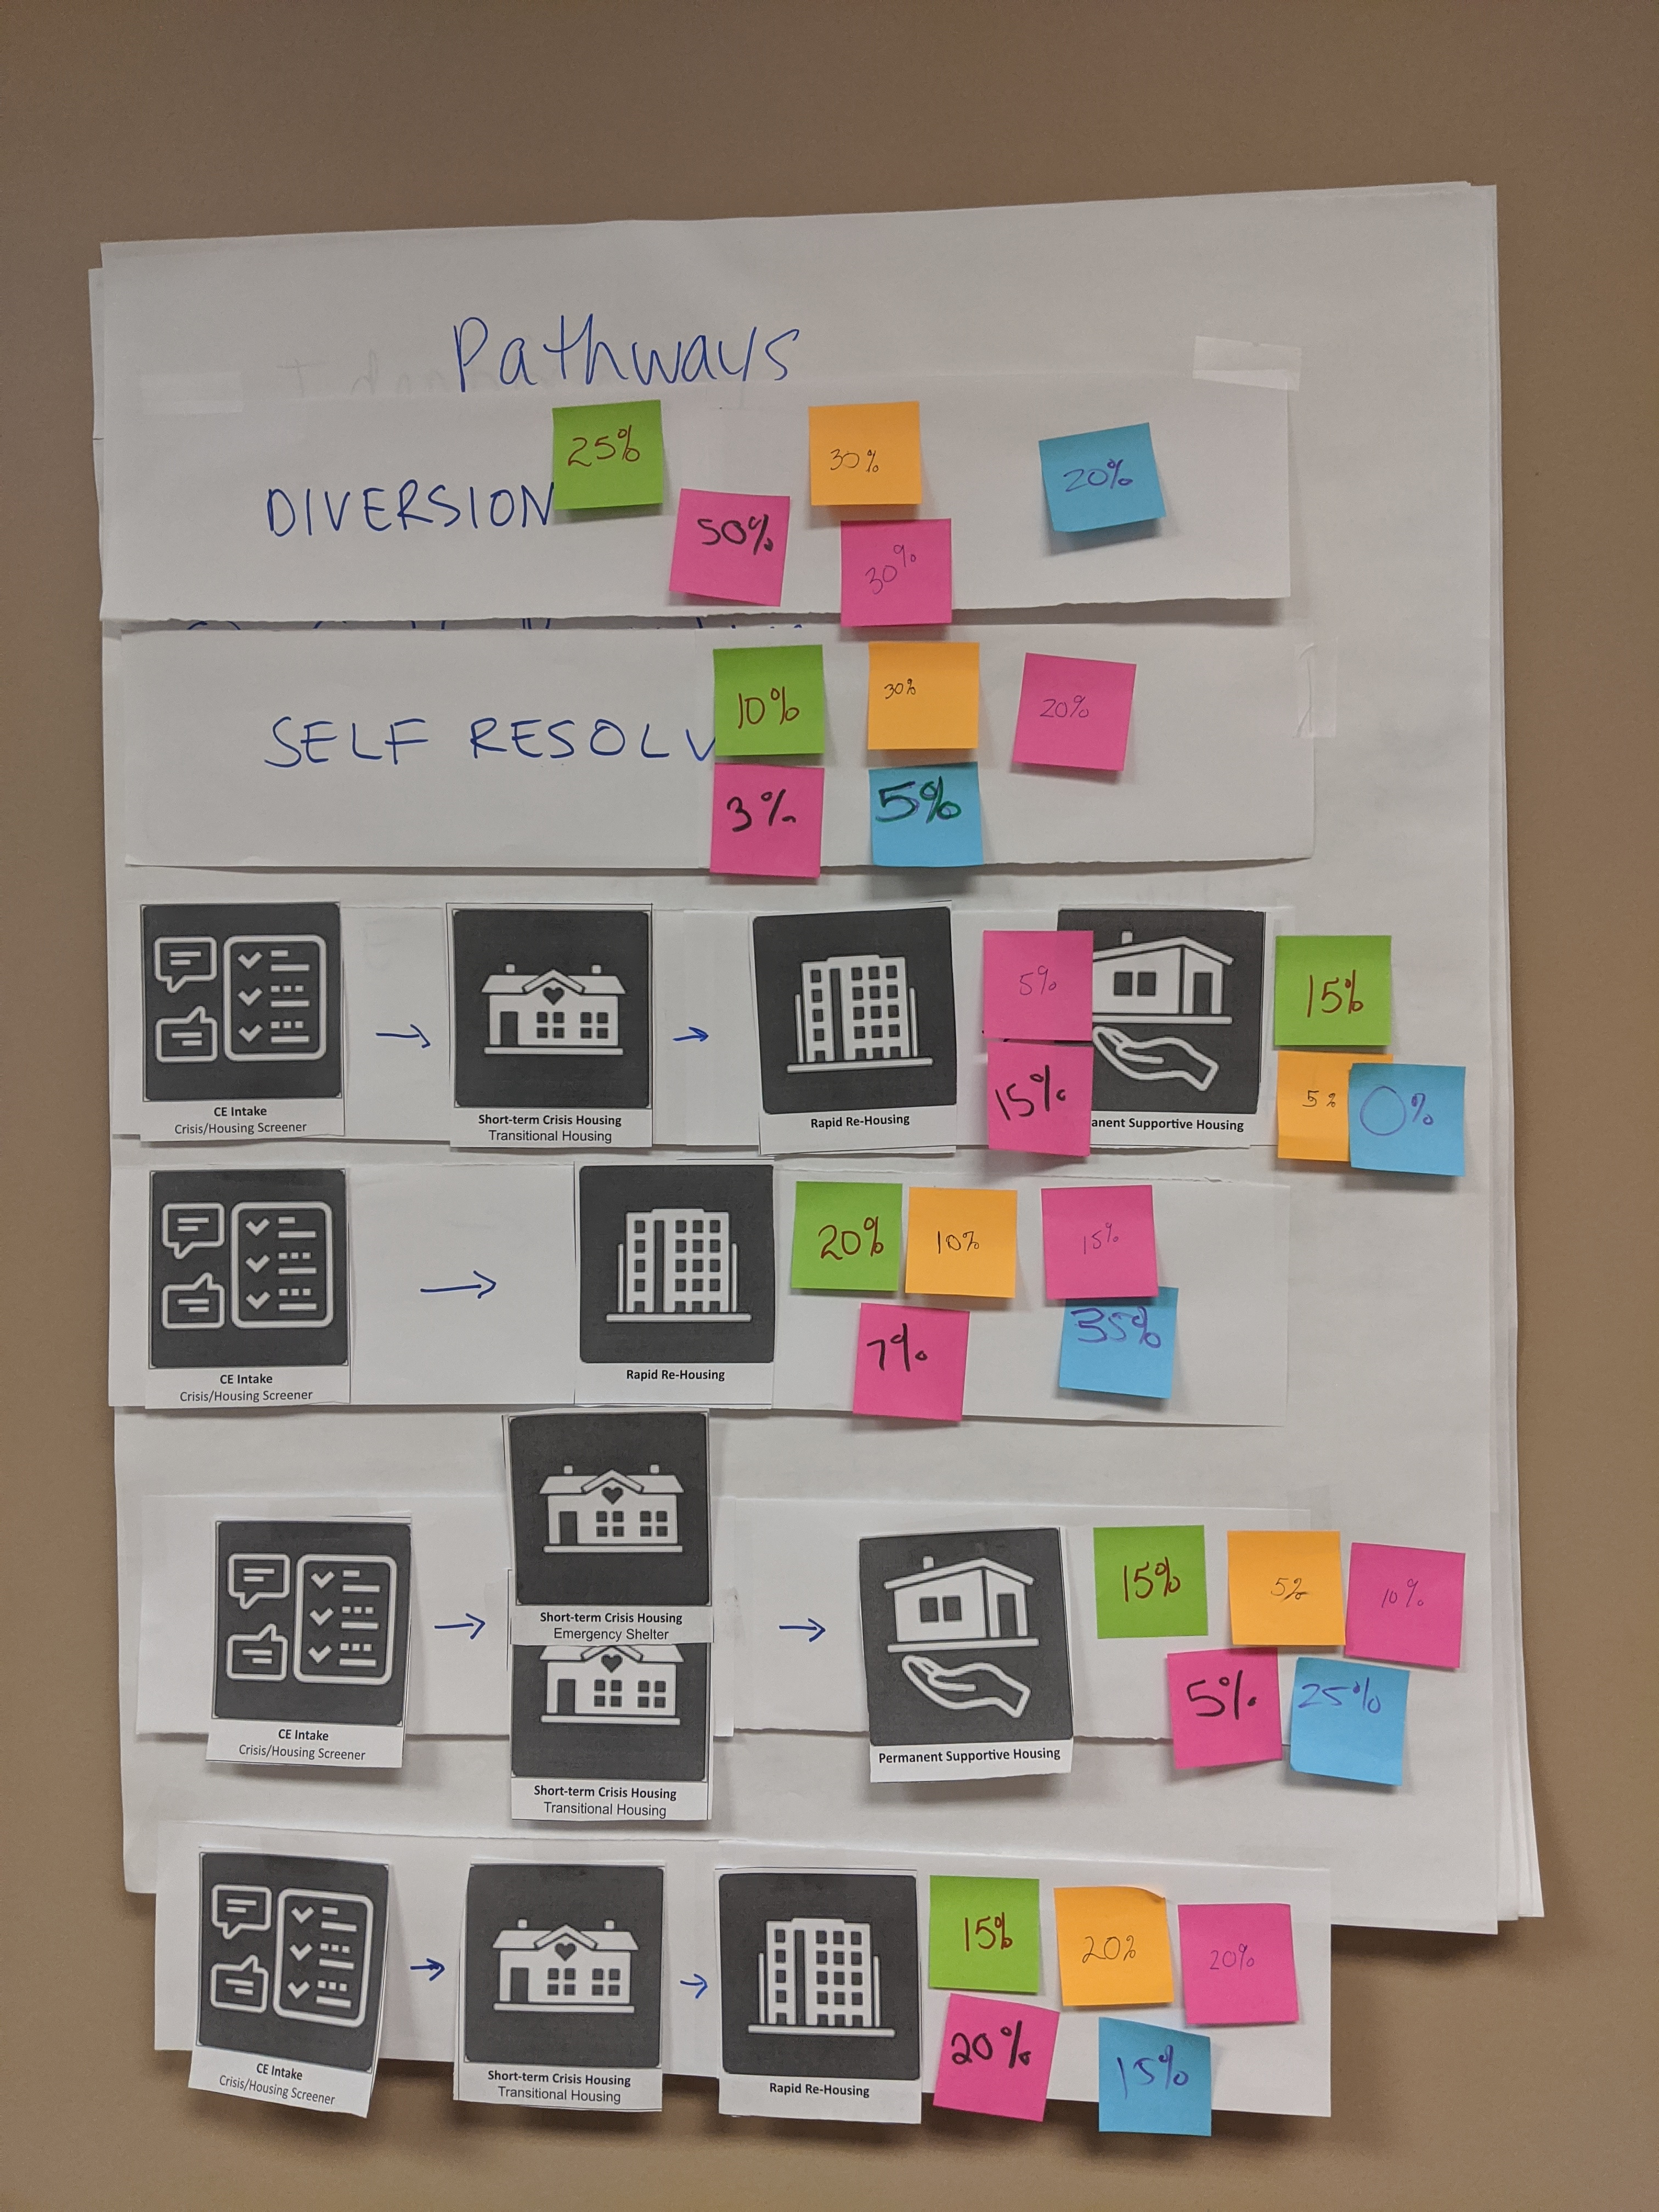
Determine Proportions in each Pathway
Using the pathways we brainstormed, assign a percentage of youth who you think will need this pathway.
After 40 minutes, we will all travel to each group’s system for the report out

Slide 33


Let’s Talk about Authentic Youth Collaboration with….
Dana White
Program Officer &
Youth Collaboration TA Provider

Slide 34
Next Steps
Next Meeting Scheduled:
January 8, 2020

Slide 35

Closing/Questions

